Slide 1
Marketing and Retail Analytics
By : Dipesh Sanas

Slide 2
AGENDA
Objective
Background
Key findings
Recommendations
Appendix:
Data Sources
Data methodology
Data model assumptions

Slide 3
OBJECTIVES
Identifying the most ordered products by quantity and by revenue.
Identifying the product and its product category which contribute maximum to the revenue.
Identifying the items which are more likely to be purchased individually or in combination with some other products (Most frequently bought products).
Managing the Inventory to reduce the inventory cost.

Slide 4
BACKGROUND
O-list, an e-commerce company like any other company they also had wide variety of products.
To meet the demand of customers they stored tons of products in their inventory
But improper management of inventory caused loss to the company
They want to manage their inventory very well so as to reduce any unnecessary costs that they might be bearing.

Slide 5
Data Cleaning and Preparation
Retail Dataset was cleaned in such a manner that no duplicates and missing values were present.
As mentioned we were asked to consider only the orders having delivery status as “Delivered” so we first filtered the dataset to as per required and then did the cleaning.
Treating the missing values in “order_approved_at” and “order_delivered_timestamp” column of “orders” table
Replaced the values of order_approved_at with order_purchase_timestamp
Replaced the values of order_delivered_timestamp with order_estimated_delivery_date

Slide 6
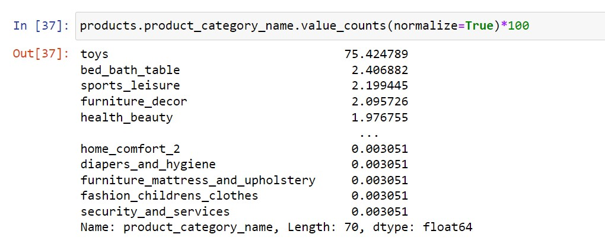
Data Cleaning and Preparation
We found out that “Toys” was the major product category having covered the 75% of all category.
So it was obvious that any missing values in the product table has to be replaced by “Toys” category.
While cleaning data I replaced the missing values in numerical columns of “Product” table with median values and not with the mean values since the data was skewed.
Cleaned data provides an accurate insights
Help us to understand the key insights for analysis and decision making.

Slide 7
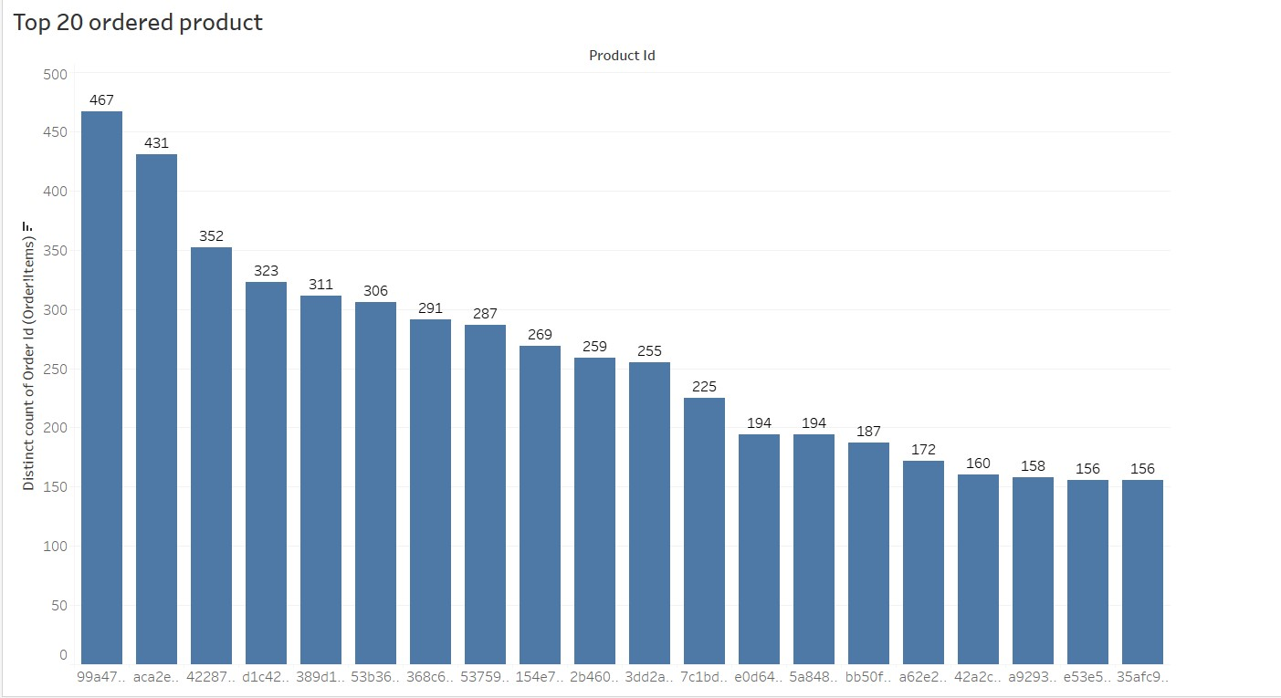
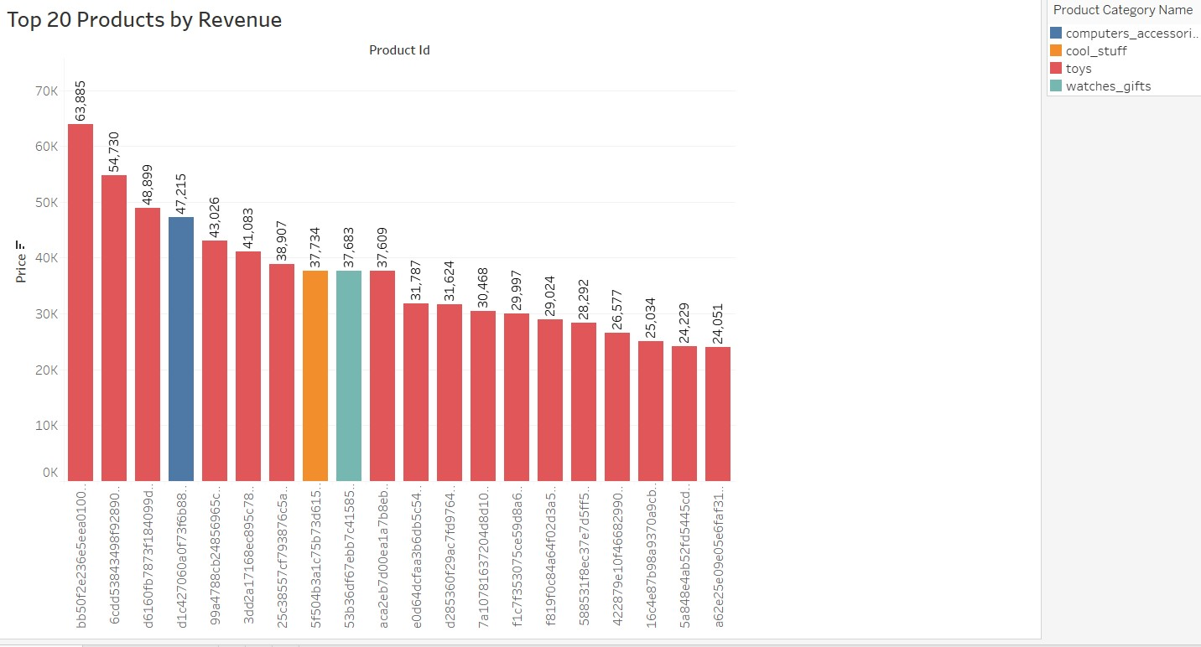
Top 20 Products
Toys was the most ordered product from the product category
Toys was the major revenue generator among all product category.

Slide 8
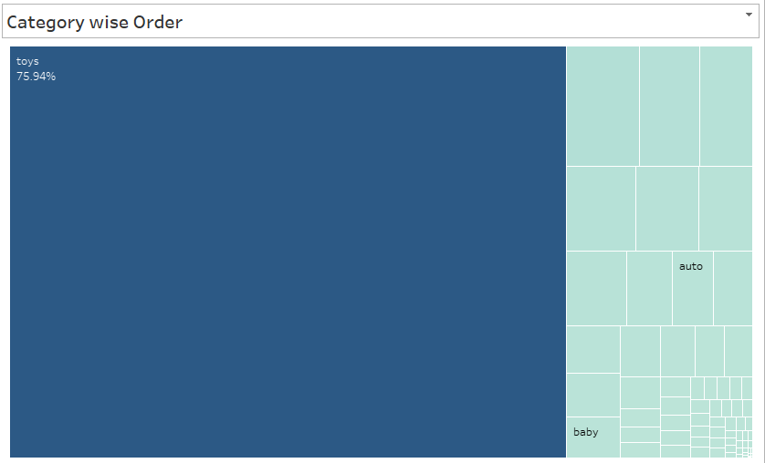
Category wise Visualiztaion
Toys was the most sold product among all the product category.
So we need to consider that the stock of this category need to be maintained.
Toys alone contributes 75.94% to the total revenue, which can be seen in visual.

Slide 9
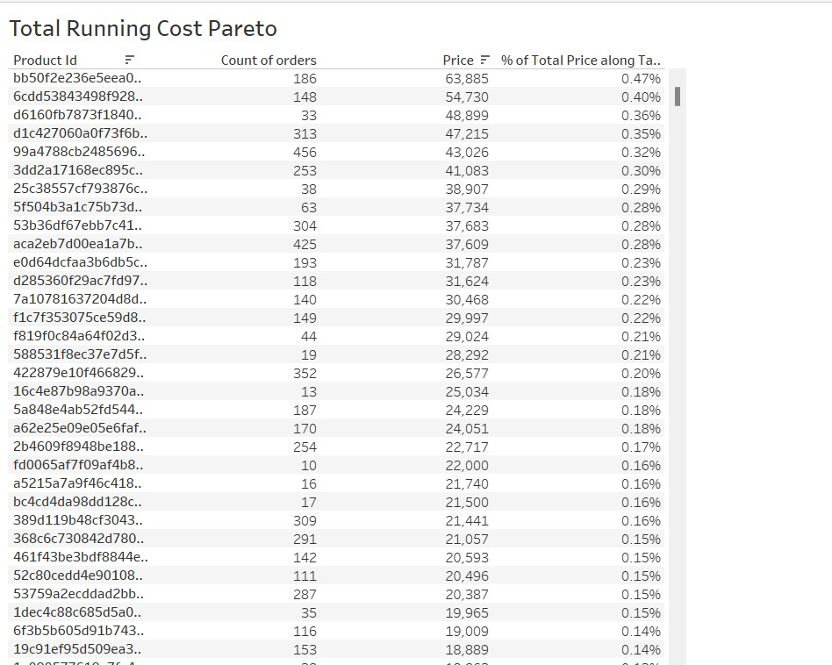
Pareto Analysis
Toys, health_beauty, and watches_gift combined generated 80% of the revenues. So we need to consider that the stock of this category need to be maintained.
Toys is the highest selling products alone contribute to 75% of total revenue.
Rest other category contributes only 20%

Slide 10
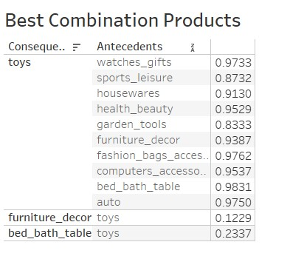
Market Basket Analysis
Toys category is the most frequently purchased item individually having the highest support value of 0.97
We can say that those customer who bought bed_bath_table also can buy toys if a good offer/discount is provided.
2nd most sold product health_beauty is not the frequently bought item.

Slide 11
Recommendations
Always check the product stock which incur 80% of the Revenue. Always keep them in stock and if required restock in advance.
Products which are not the major contribute to the revenue should not be stocked.
Consider providing good offers on slow moving stocks, to move them quickly.
Provide discounts on the products which go well along with toys.

Slide 12
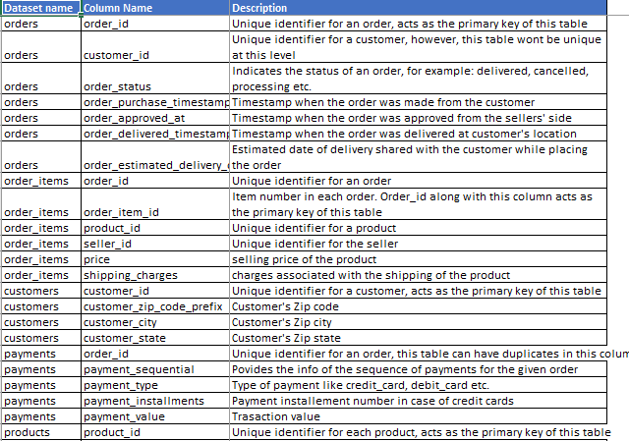
DATA SOURCES
Here is a snapshot of our data dictionary:

Slide 13
APPENDIX – Data Methodology
We conducted a thorough analysis of the retail dataset.
Cleaning and preparing the data set using the Python Libraries in Jupyter Notebook.
Further Data visualization was done on Tableau.

Slide 14
Thank You!

